Slide 1

Sprocket Central Pty Ltd
Data analytics approach
Intern, Sharika Anjum Mondal, 2020

Slide 2
Agenda
Introduction
Data Exploration
Model Development
Interpretation

Slide 3
Introduction
Customer Analysis – To get which are the areas the company should concentrate to get maximum profit.
Gender distribution
Age distribution
Product buying ratio (on the basis of gender and age)
State distribution
Customer distribution to check online order preferred or not (on the basis of age)
Product size, class and line mostly preferred by customers
Model Development for knowing the purchase rate in the upcoming years
Interpretation

Slide 4
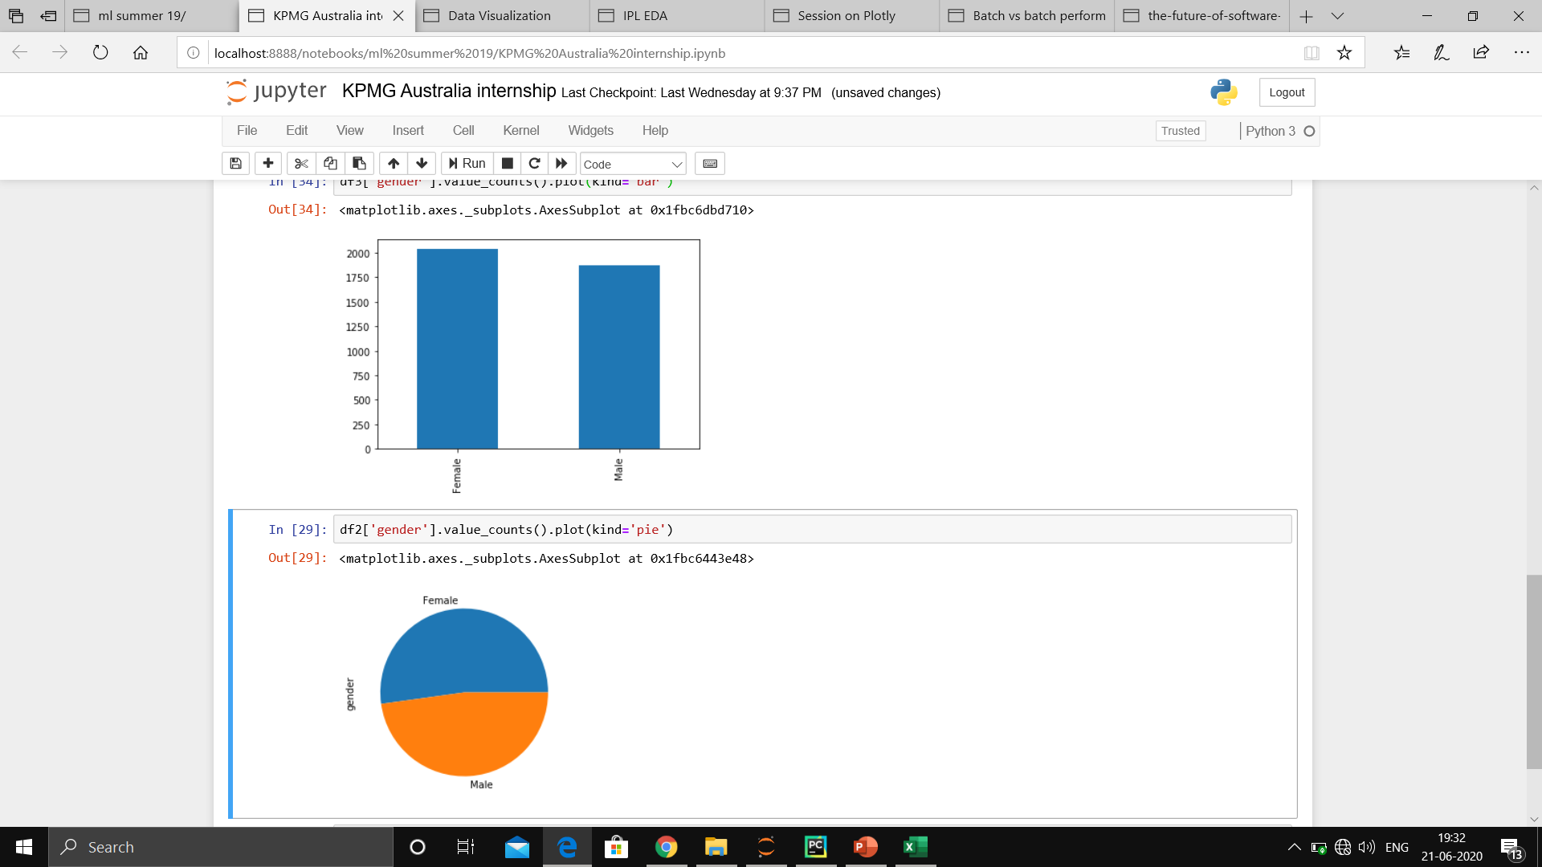

Data Exploration
Gender Distribution
The bar graph shows the gender distribution in the old customer (CustomerDemographic) dataset.
The pie chart shows the gender distribution in the new customer’s dataset.
Both picture shows the female to male ratio is high.
Thus, we can see females get more easily attracted by our products.

Slide 5
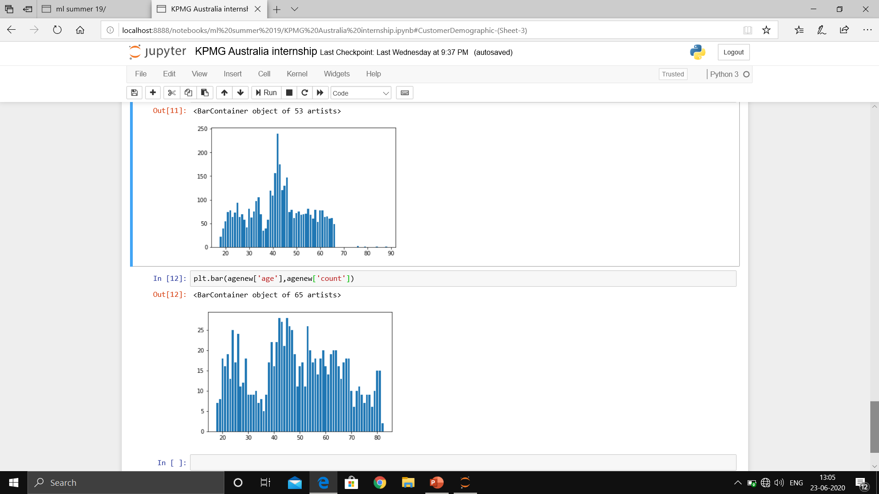

Data Exploration
Age Distribution
The 1st picture shows the gender distribution in the old customer (CustomerDemographic) dataset.
The 2nd picture shows the gender distribution in the new customer’s dataset.
The 1st picture shows that the age between 40 – 45 have attracted more customers than the rest.
However, the 2nd picture shows extremely un-even distribution. (A very positive highlight for the company)

Slide 6
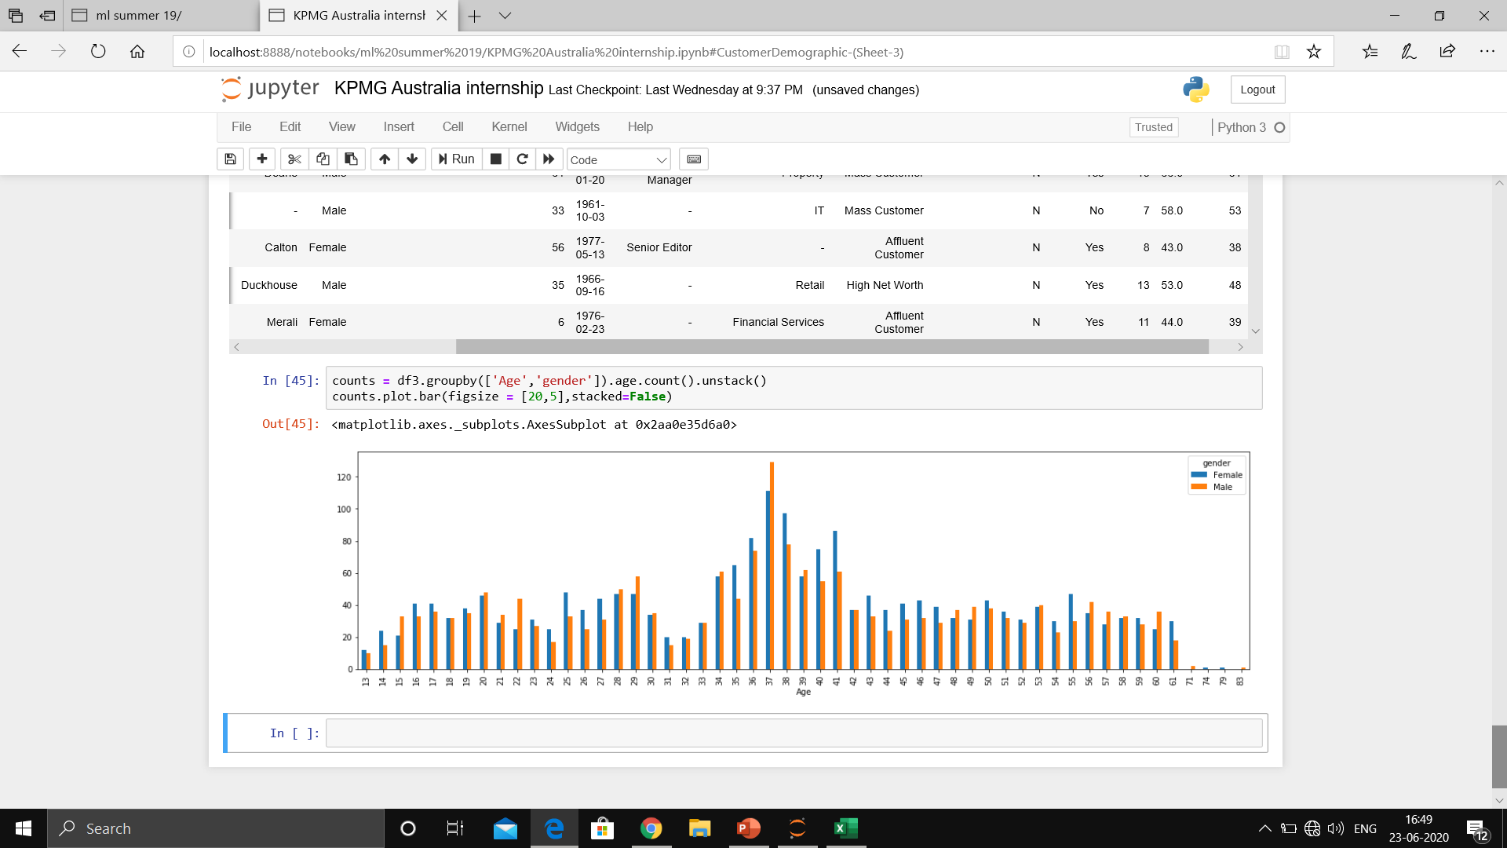
Data Exploration
Product buying ratio(on the basis of gender and age)
The picture shows the buying ratio of female : male in each age group.
The age between 34-42 attracts maximum customers.

Slide 7
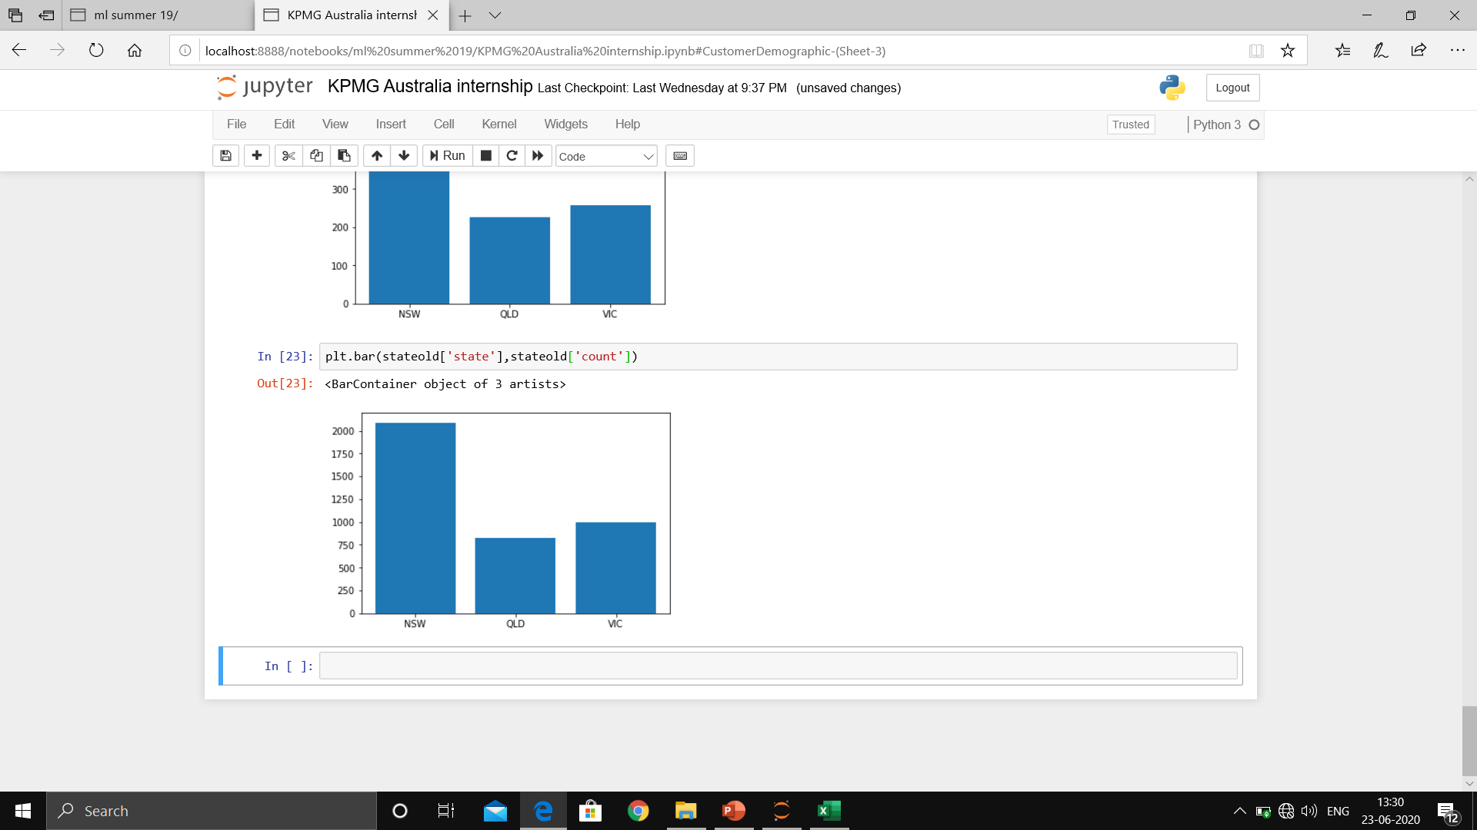
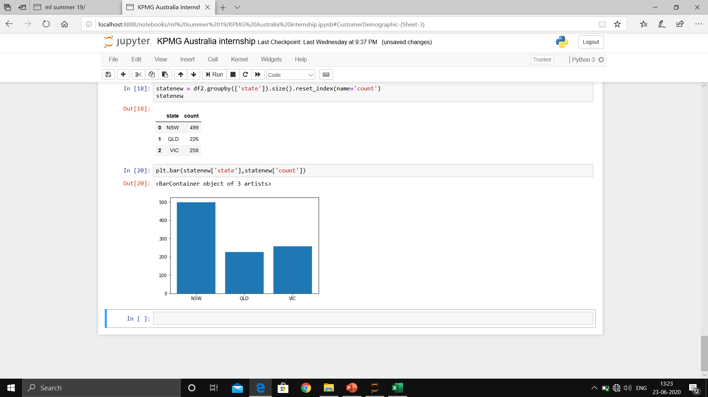
Data Exploration
State Distribution
The 1st picture shows the state distribution in the old customer (CustomerAddress) dataset.
The 2nd picture shows the state distribution in the new customer’s dataset.
The 1st picture shows that mainly customers come from NSW.
However, the 2nd picture shows mainly customers come from NSW.
No change as such is seen.

Slide 8
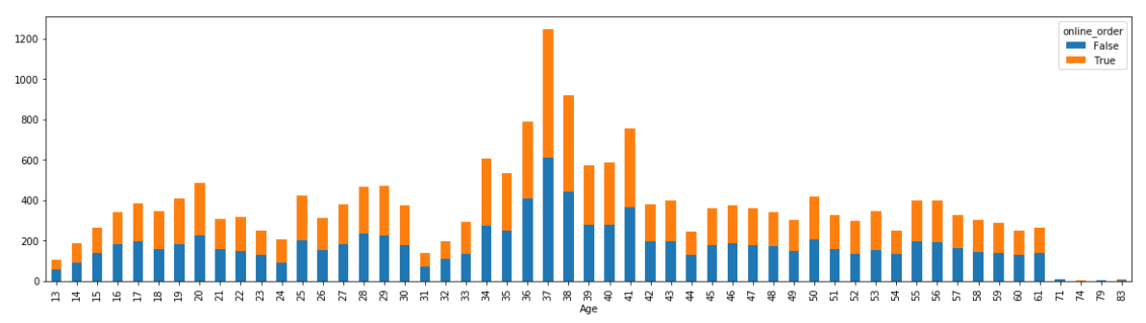
Data Exploration
Customer distribution to check online order preferred or not (on the basis of age)
The picture that online order preferred or not in each age group.
We see that online orders are mostly preferred in each age group.

Slide 9
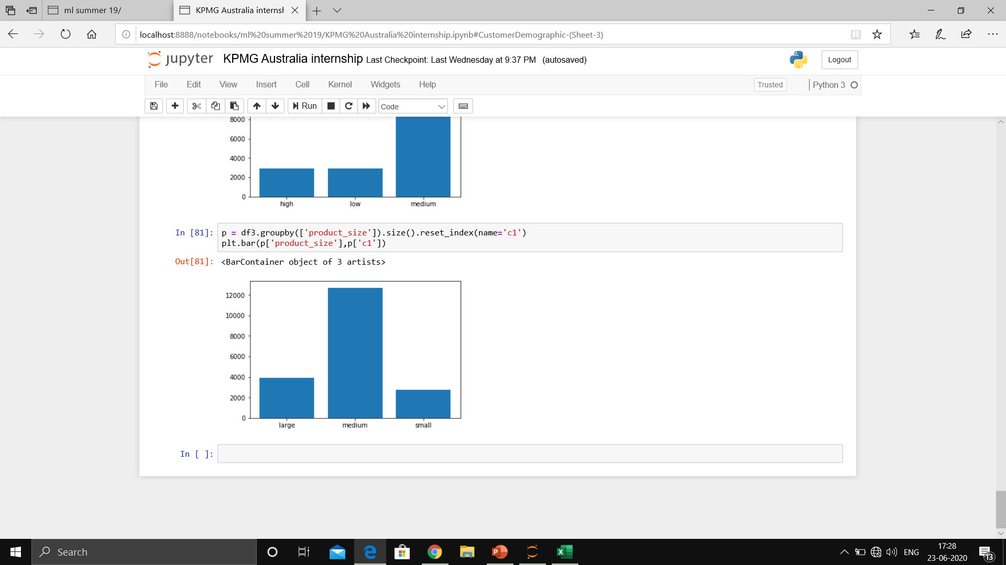
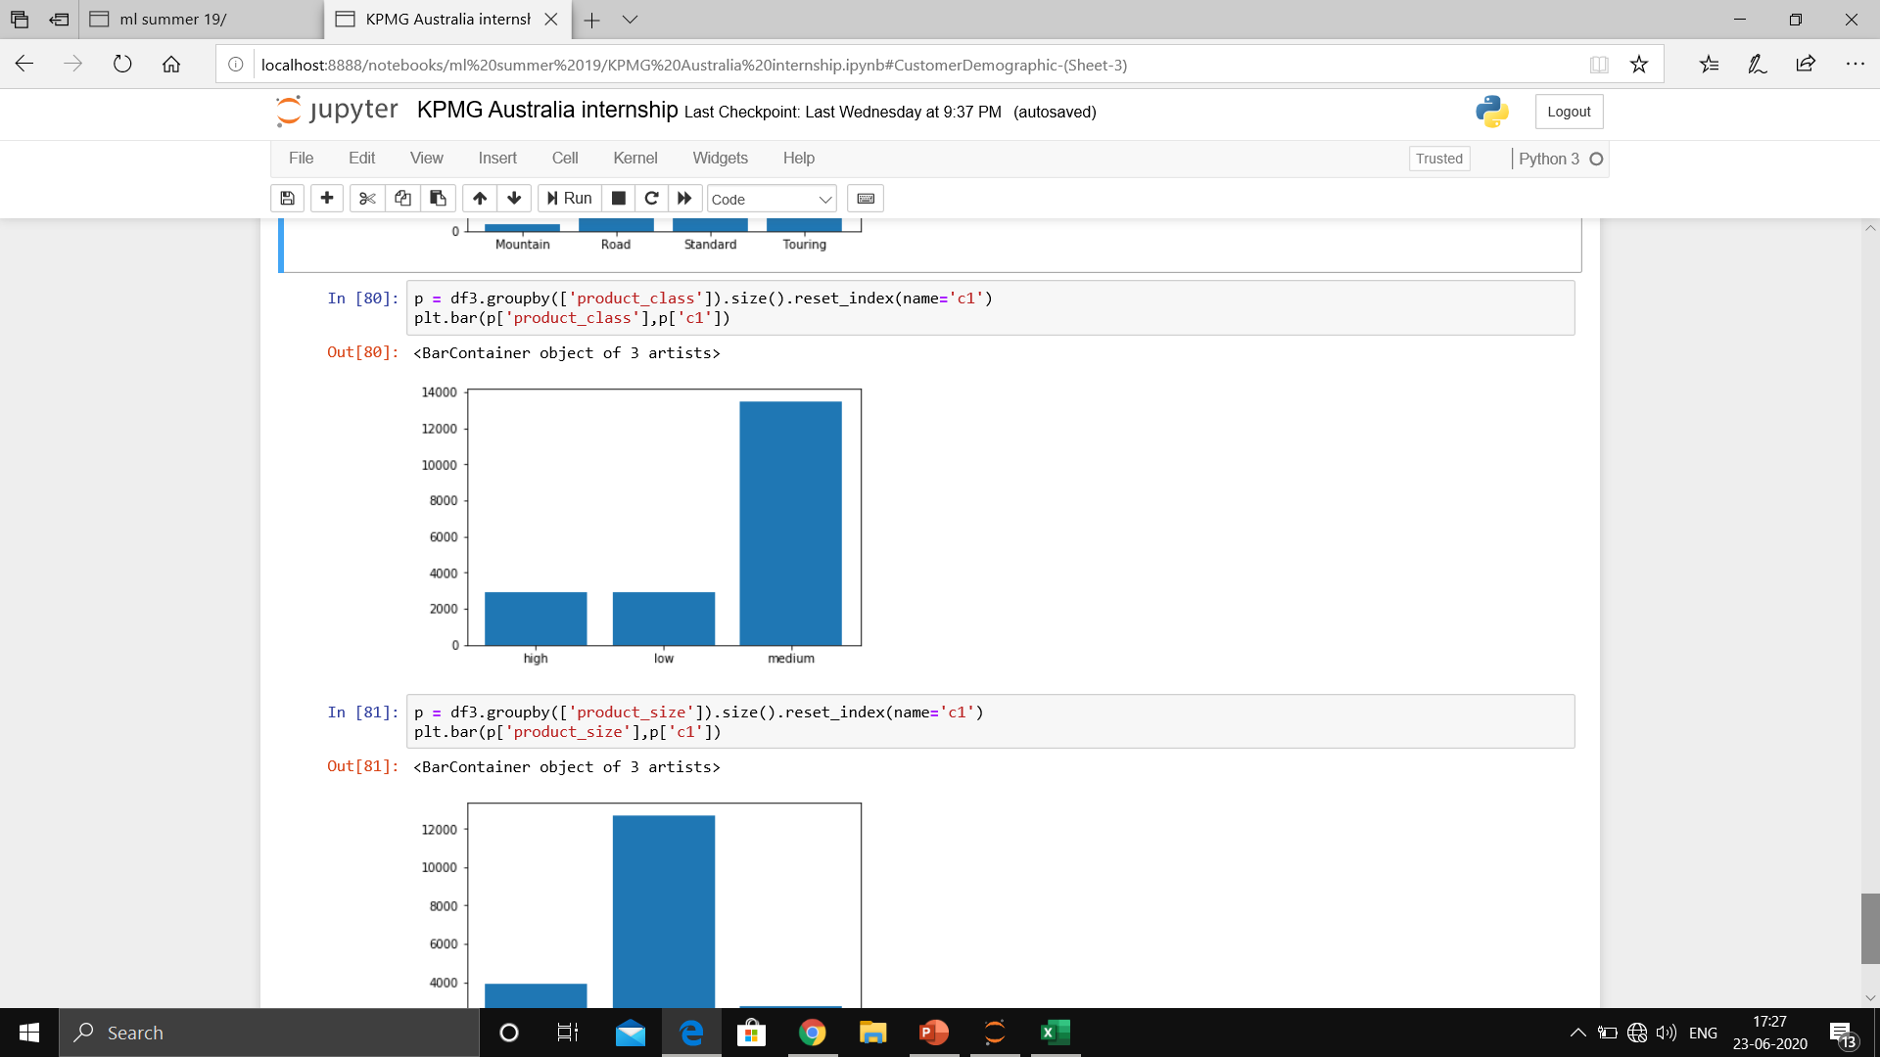
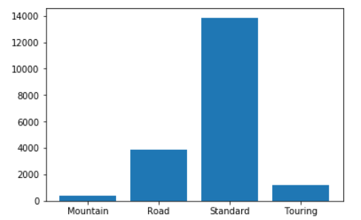
Data Exploration
Product size, class and line mostly preferred by customers
The 1st picture shows product size distribution where we can see medium size products are mostly in demand.
The 2nd picture shows product class distribution where we can see medium class products are mostly in demand
The 3rd picture shows product line distribution where we can see standard line products are mostly in demand.

Slide 10
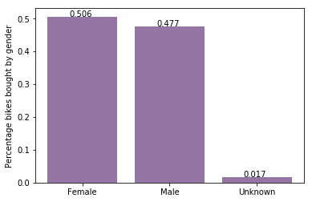
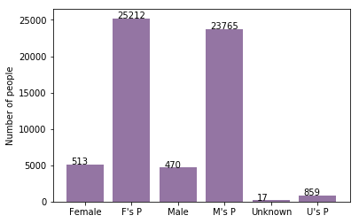
Model Development for knowing the purchase rate in the upcoming years
Bike purchases last 3 years/ percentage purchased
As we can see, our new customers mostly Female with 50.6% purchases with total of 25,212 bikes
Male contributed to 47.7% purchases with 23,765 bikes
A regression model will work better to predict what will be the purchase ration in the upcoming years for the company.

Slide 11
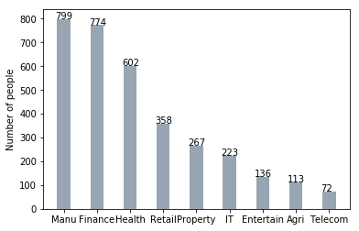
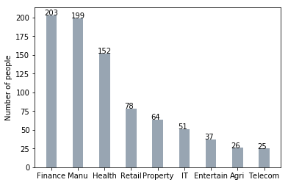
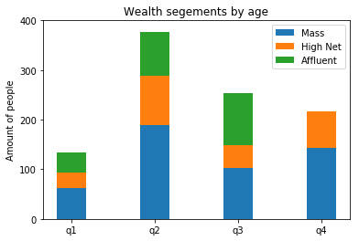
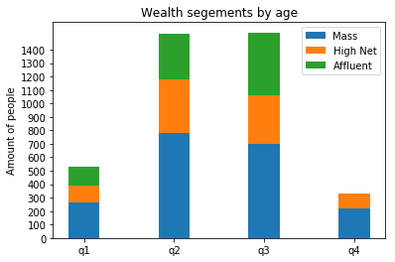
Interpretation
Job industry category
Mostly our new customers are on Finance industry and our Manufacturing customers are still on top 2.
The rest industries is still same
Wealth segments
In all ages, the number of Mass Customers is the highest so we should focus on this social class.
After that, we should focus on High Net Customer.
Then Affluent Customers but mostly second and third quadrant

Slide 12
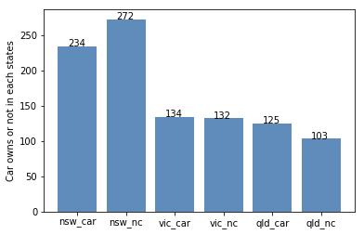
Interpretation
Customer distribution of owning a car
NSW should be considered the most since numbers of customers don’t own cars is significantly larger than that own.
VIC and QLD has more customers that own car that who don’t but we can try to have something so that those owns car will buy bikes.

Slide 13
Interpretation
Since our products are mostly attracting female customers so we should advertise keeping that in mind. However, we just can’t let the male customers go. We can make a feedback system for the male customers, so that we can understand at which point we are lacking in-order to fulfill our male customers demand.
A very good difference have been observed in our age distribution graph between our old and new customers. We are proudly attracting all age groups by our products. However, we should concentrate more on the age group of 30-50, because that will fetch us maximum profit.
We see, undoubtedly the rate of online orders is more than offline. Thus we need to make our online system a lot more efficient and accurate to attract more customer’s satisfaction.
Clearly, we see : Product – size : Medium, product-class : Medium, Product-line : Standard – are high in demand. Thus these categories should have more production so that we can never run out of stock. Also, a feedback for not in-demand categories will help us to improve those products.

Slide 14
Appendix

Slide 15
Appendix
Programming language used for the analysis – Python
Software used – Anaconda ( Jupyter Notebook)
For modelling – Machine Learning concepts is used.

Slide 16
Thank You

